Slide 1
Welcome
1

Slide 2
Presentation by
16101200 - MITHUN DAS

Slide 3

E-Commerce Website
SUP ONLINE SHOPPING

Slide 4
Contents
What is E-Commerce?
What is the purpose of our Project?
Tools and Languages.
How our Website works?
What we learned from this project?

Slide 5
E-Commerce
It is commonly known as electronic marketing. It consist of buying and selling goods and services over an electronic system such as the internet .
E-commerce is the purchasing , selling & exchanging goods and services over computer network or internet through which transactions or terms of sale are performed electronically or some times its cash on delivery.

Slide 6
Purpose of Our Project
The purpose of this project is that any person can sell their product online and earn cash. Because E-commerce is the buying and selling of goods and services, or the transmitting of funds or data, over an electronic network, primarily the Internet.

Slide 7
Languages and Tools
LANGUAGES
HTML5
CSS3
JAVASCRIPT
PHP
SQL DATABASE
TOOLS
PHOTOSHOP
BRACKET
NOTEPADE++

Slide 8
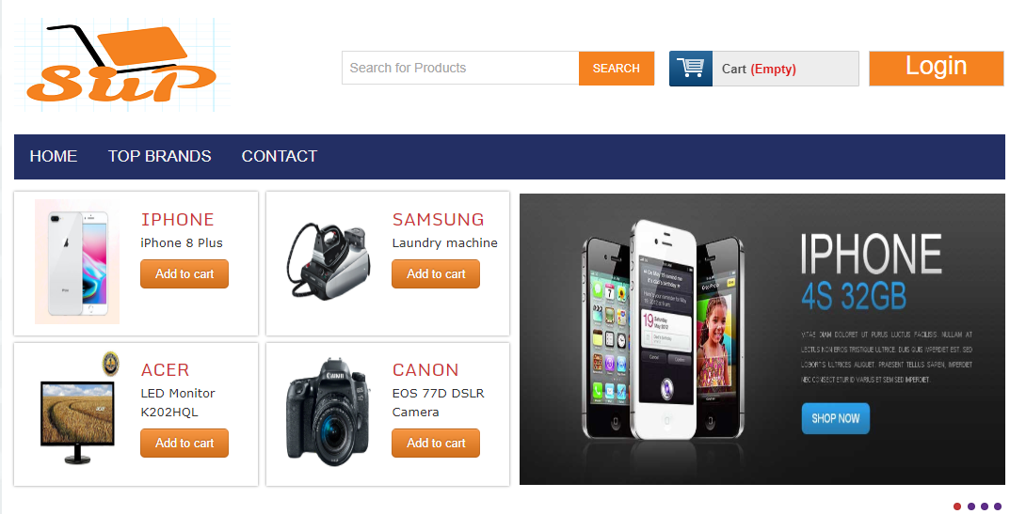
HEADER

Slide 9
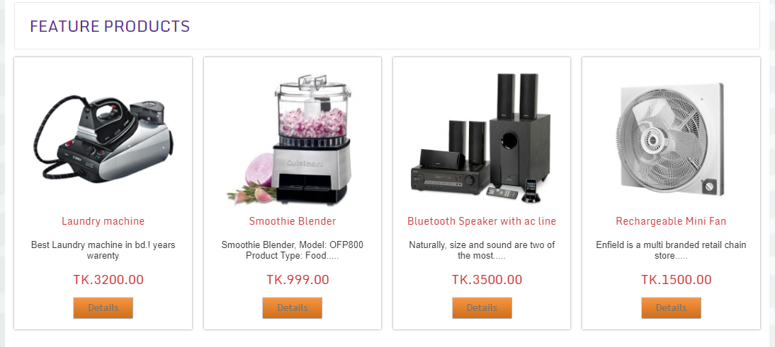
FEATURE PRODUCTS

Slide 10
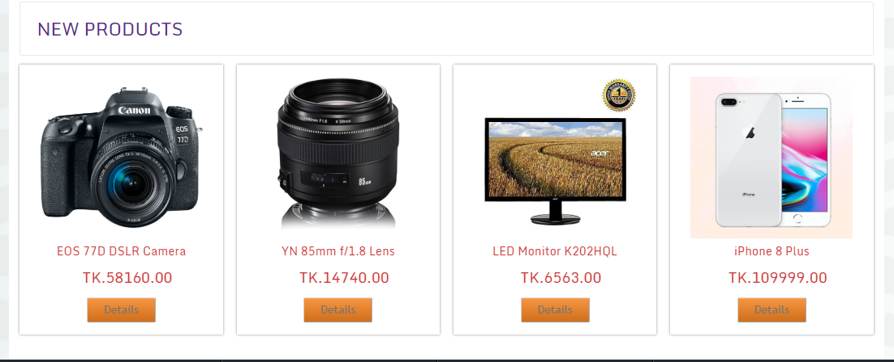
NEW PRODUCTS

Slide 11
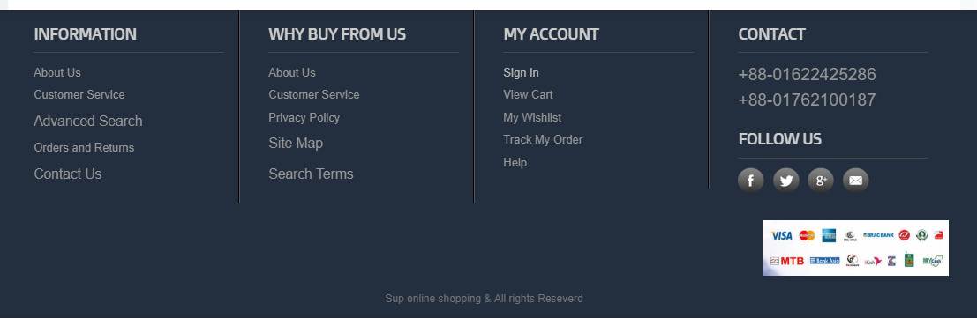
Finally footer

Slide 12
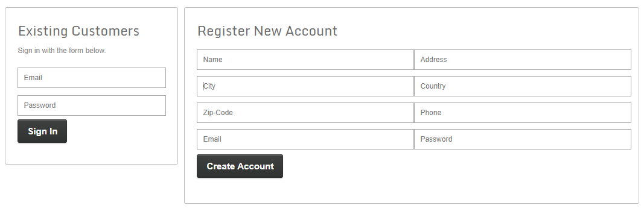
LOGIN and REGISTER

Slide 13
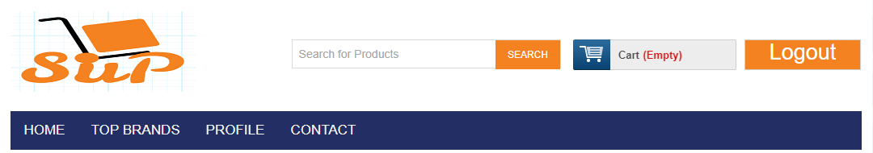
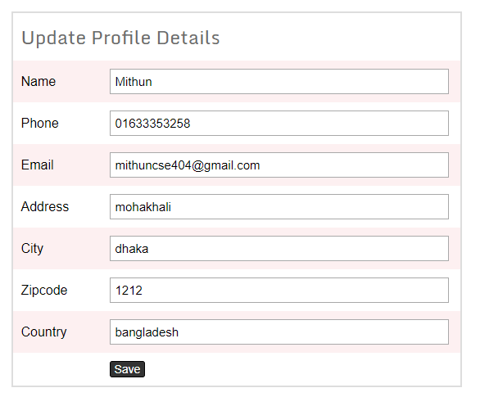
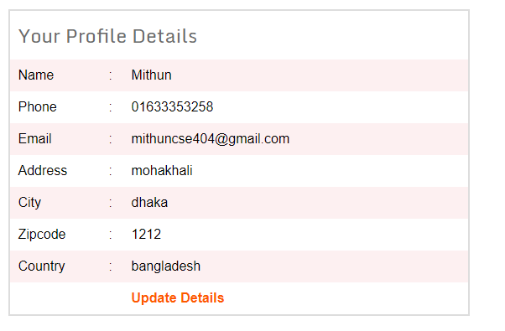
USER DETAILS
User Profile

Slide 14
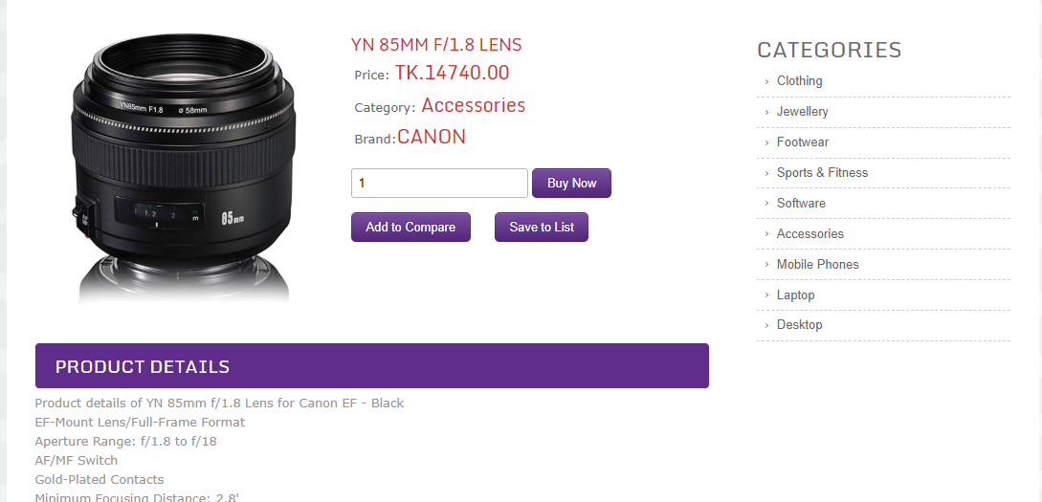
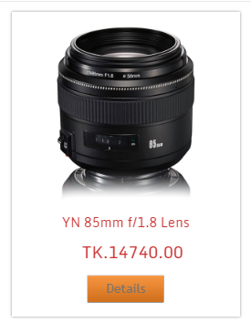
Lets see how user buy a product

Slide 15
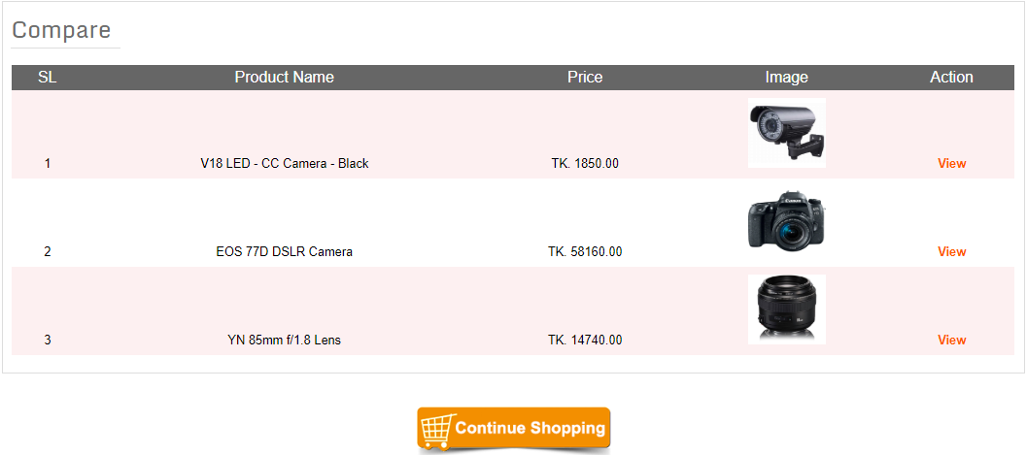
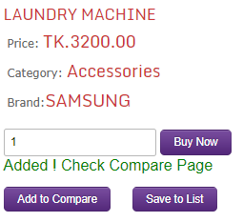
COMPARE YOUR PRODUCT

Slide 16
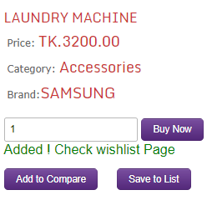
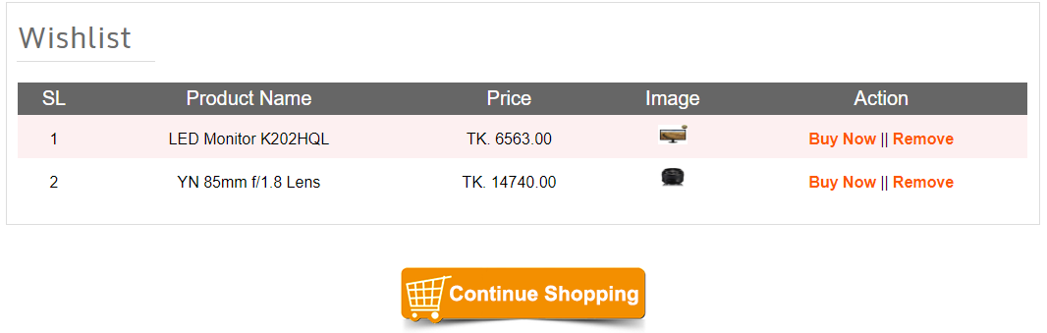
WISHLIST

Slide 17
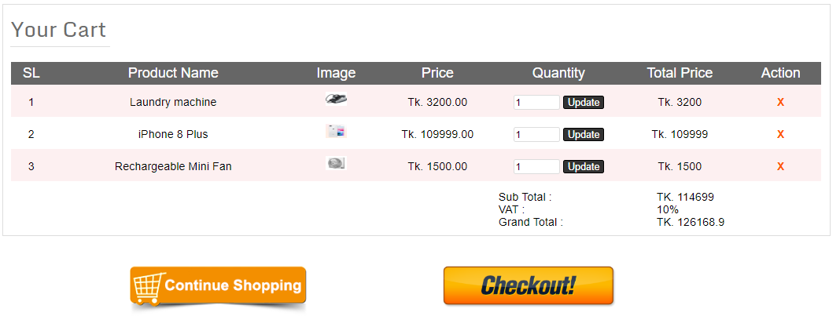
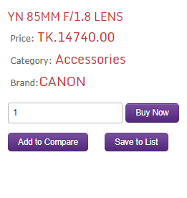
BUY NOW

Slide 18
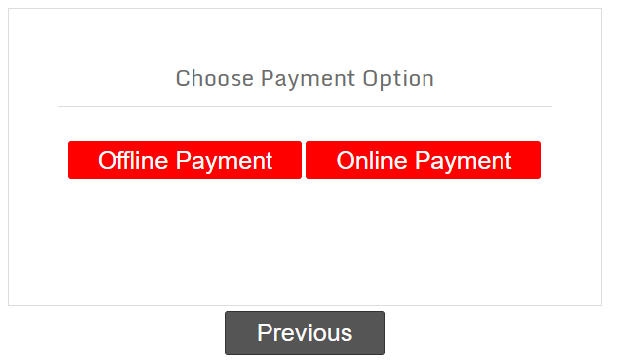
PAYMENT

Slide 19
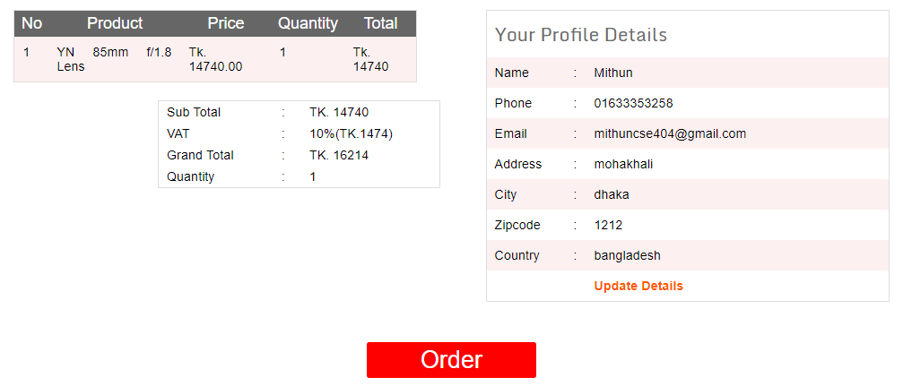
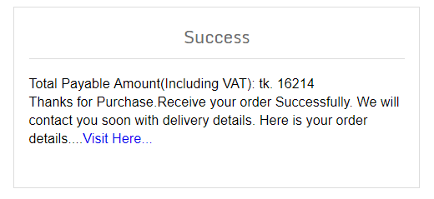
PAYMENT DETAILS

Slide 20
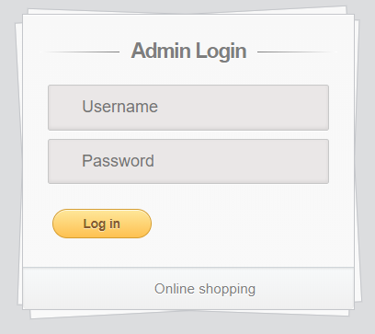
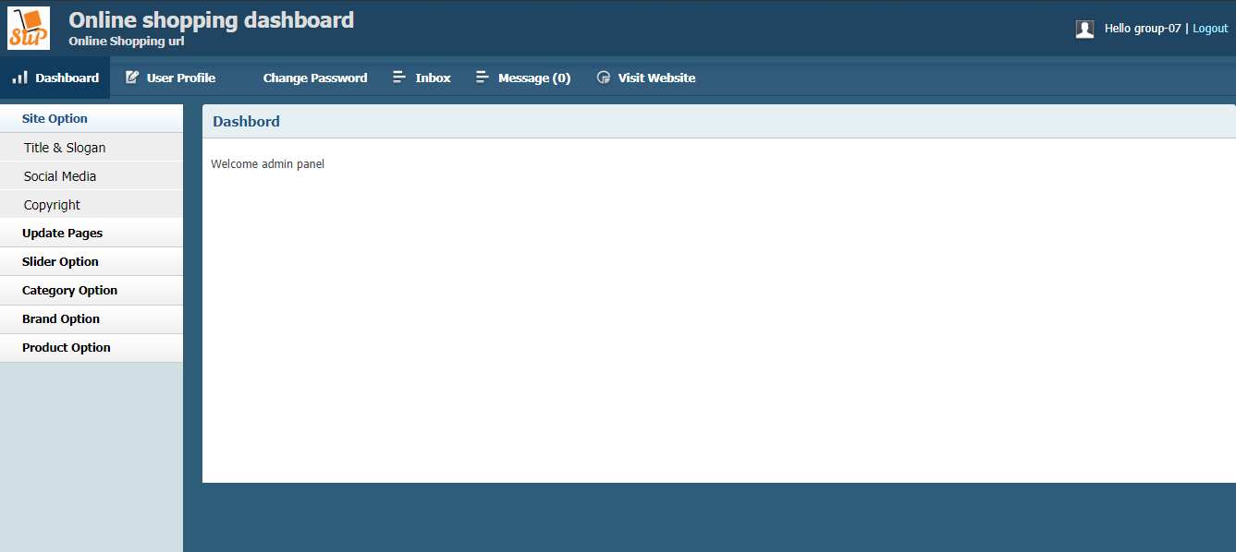
ADMIN PANEL

Slide 21
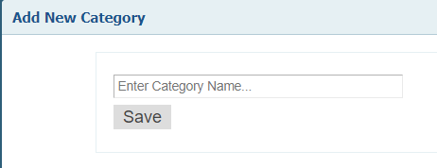
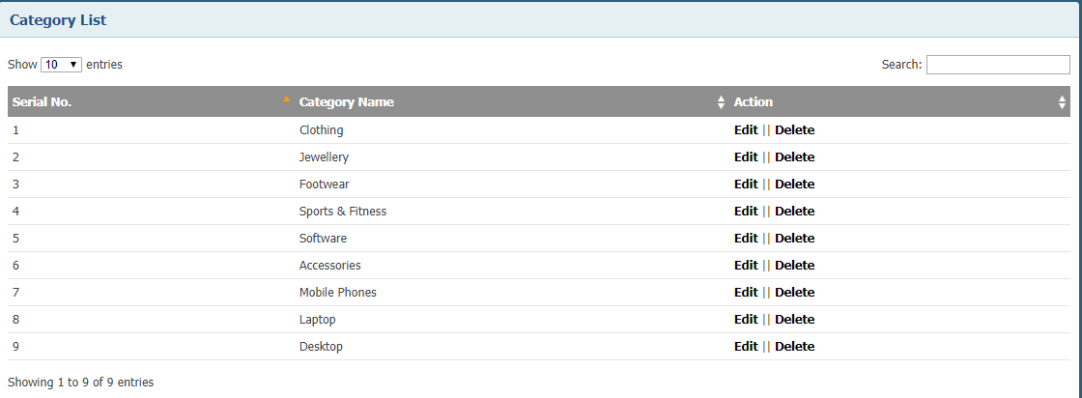
ADD CATEGORY

Slide 22
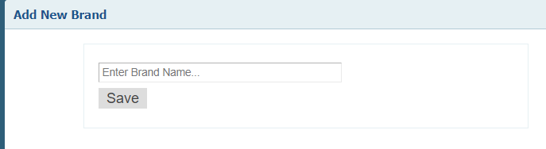
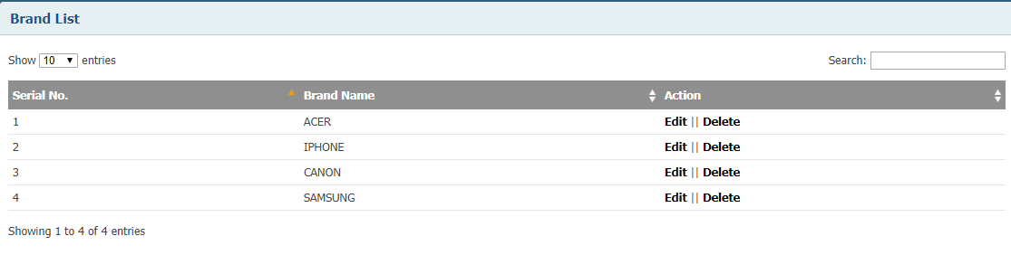
ADD BRAND

Slide 23
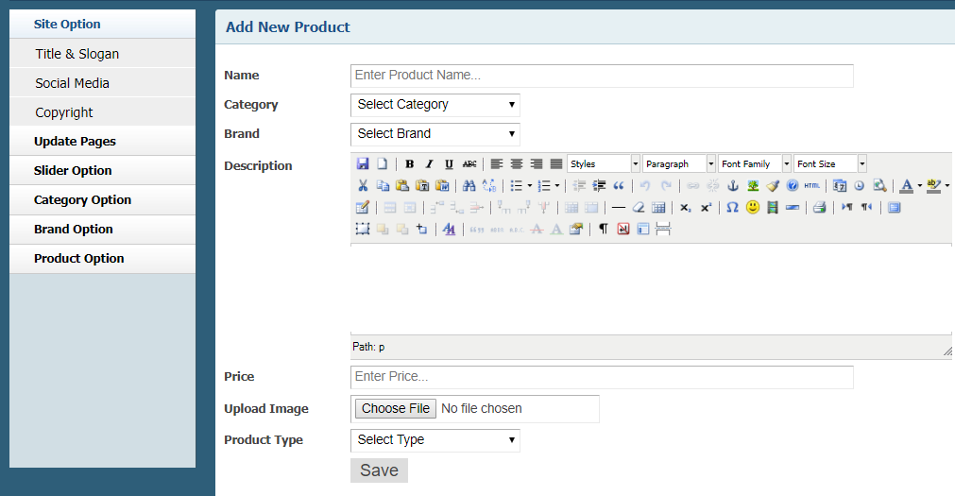
ADD PRODUCT

Slide 24
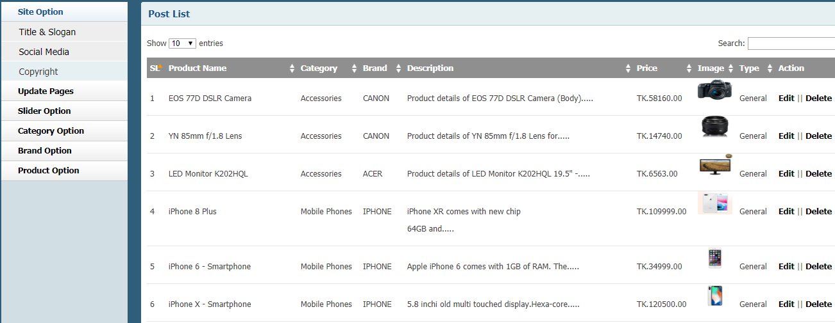
PRODUCT LIST

Slide 25
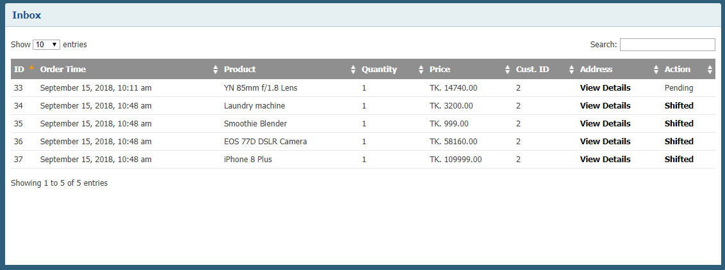
RECEIVE ORDER AND CONFIRM

Slide 26
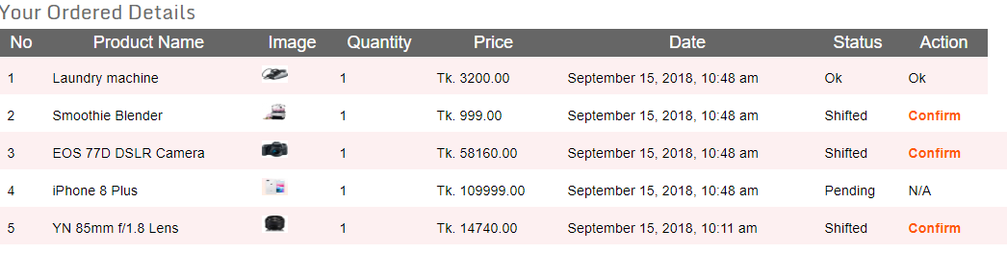
USER CONFIRMATION

Slide 27
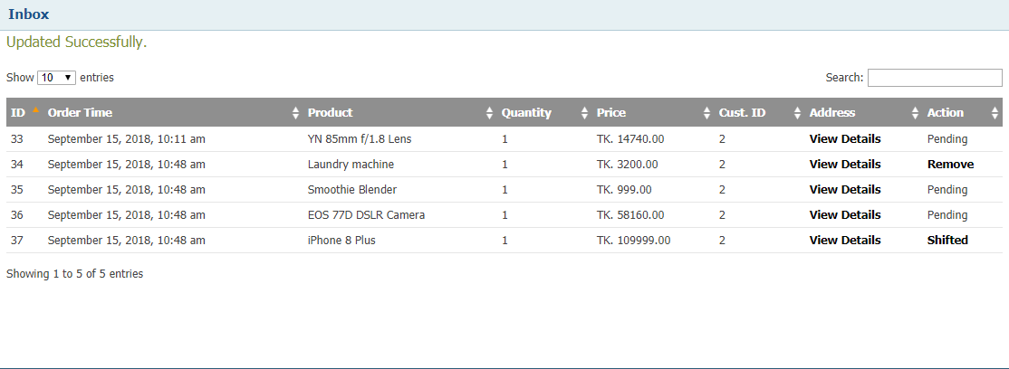
NOW ADIMN REMOVE PRODUCT

Slide 28
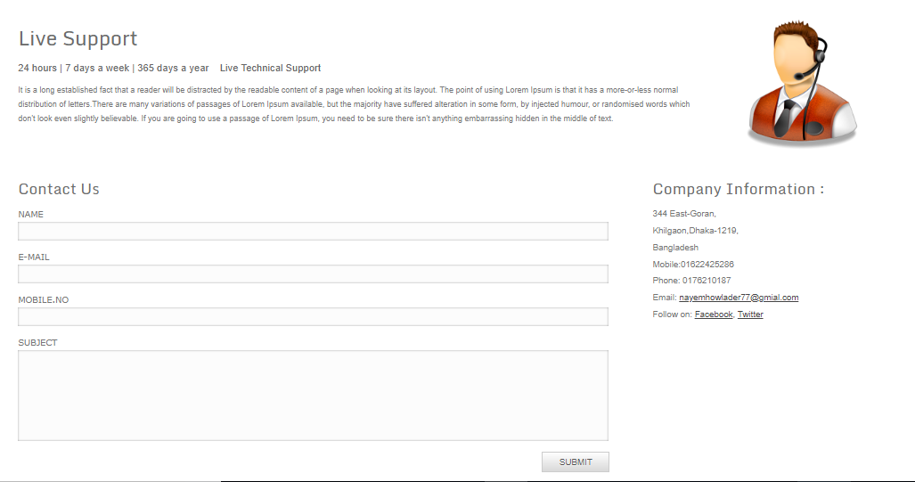
IF YOU FELL ANY QUERY THEN CONTACT

Slide 29
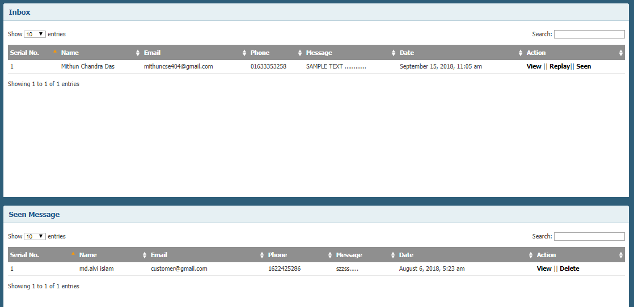
NOW ADMIN RECEIVE THIS SMS

Slide 30
What we learn from this project
How to create interactive design using Html5, Css3, JavaScript slider etc.
Basic syntax of PHP.
PHP form validation.
Database Connection by PHP.
PHP Session.
Different types of operation using SQL.

Slide 31


Slide 32


